Slide 1


E-Hunter
Team Members:
1. Syed Sami Sayem : 20245103247 (Team Lead)
2. Tasmia Anwar Nisa : 20245103261
3. Sourav Chandra Shil : 20245103254
4. Raisa Sadik Smrity : 20245103248
5. MD Tanvir Islam : 20245103244
BUBT Dept. CSE

Slide 2





Table of Contents
Why we choose this game
Why you would like to play this game
Game Features
Game Mechanics
Technical Details
Conclusion
..........................

Slide 3
Why we choose this game?
Iconic and Recognizable
Simple Yet Engaging Gameplay
A Revolution for gaming industry

Slide 4
Why you would like to play this game
Nostalgia and Familiarity
Strategic Gameplay
Variety and Replayability in Your Version
Engaging and Addictive Gameplay
Fun and Stress Relief

Slide 5
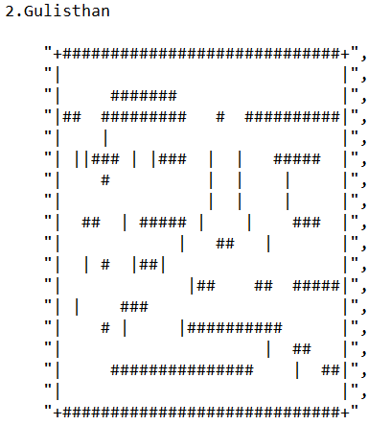
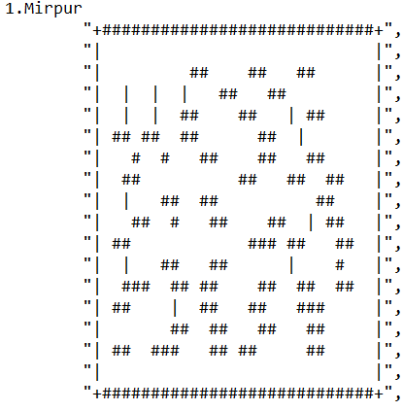
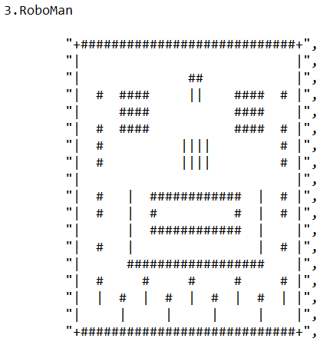
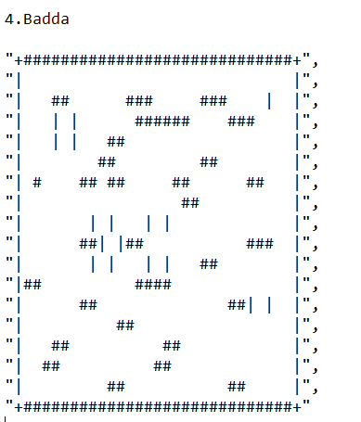
Game Features
Maps:
Game Modes:
Easy
Medium
Hard

Slide 6

Game Mechanics
1. Core Objective
Primary Goal: The player controls E-Hunter and navigates through a maze to eat all the pellets while avoiding ghosts.
2. Player Movement
Directional Control: E-Hunter moves up, down, left, or right within the maze.
Continuous Motion: Hero keeps moving in the last input direction unless blocked by a wall or a new direction is input.
Maze Navigation: Mazes include corridors, corners, and dead ends, challenging the player to choose paths strategically.
3. Collectibles
Pellets: The primary objective is to eat all pellets in the maze
..........................

Slide 7
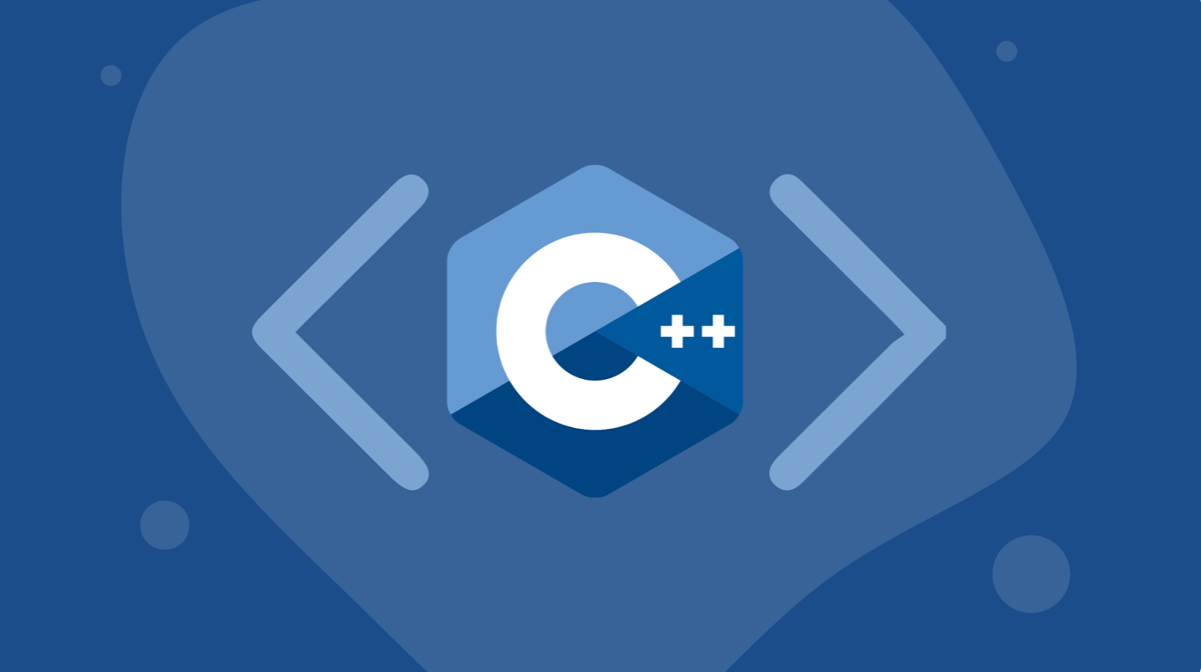
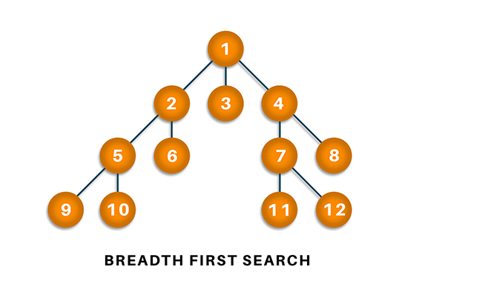
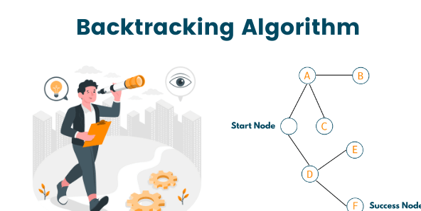
Technical Details
Programming Language:
Algorithm:
Optimize:
Optimized Screen Refreshing : Only refreshes characters on the screen instead of the entire display.
Memory Efficiency: Uses a copy of memory for smoother gameplay rather than the main memory.
Smaller Data Types: Uses short instead of int to reduce memory usage.
Efficient Pathfinding: Implements backtracking and BFS algorithms to calculate the shortest path effectively

Slide 8
Conclusion
Key Features: Multiple maps, difficulty levels, dynamic ghost AI.
Project Overview: E-Hunter remake with modern twists.
Achievements: Learned game design, programming, problem-solving.
Player Appeal: Fun, challenging, and replayable.
Future Plans: New maps, multiplayer, leaderboards.
Thank You
We appreciate your time and invite you to try the game

